Slide 1

CSE 3110 Database Systems Lab

Slide 2
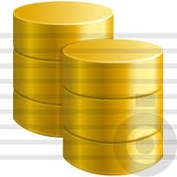
DATA
Raw Information
Every Institute or APP uses DATA
Facebook
Bangladesh Bank
KUET
users
user_friends
user_posts
user_likes
How they store DATA????
DATABASE

Slide 3
What is Database???
What name suggest…
Data + base= Database
Data means raw information
Base means holding place/storage area
Database is a store house of raw information

Slide 4
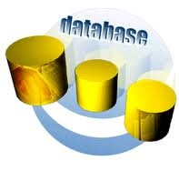
So why database to study?
Manage your information in an organized and secure way

Slide 5
Spatial
Object Relational
XML
Relational

Slide 6
Types of DATA
Structured
Relational data
Unstructured
Satellite images
Semi structured
XML and JSON documents, NoSQL

Slide 7
Example of a Traditional Database Application
Suppose we are building a system to store the information about:
students
courses
professors
who takes what, who teaches what

Slide 8
Can we do it without a DBMS ?
Sure we can! Start by storing the data in files:
students.txt courses.txt professors.txt
Now write C or Java programs to implement specific tasks

Slide 9
Doing it without a DBMS...
Enroll “Mary Johnson” in “CSE444”:
Write a C program to do the following:
Read ‘students.txt’
Read ‘courses.txt’
Find & update the record “Mary Johnson”
Find & update the record “CSE444”
Write “students.txt”
Write “courses.txt”

Slide 10
Problems without an DBMS...
Read ‘students.txt’
Read ‘courses.txt’
Find & update the record “Mary Johnson”
Find & update the record “CSE444”
Write “students.txt”
Write “courses.txt”
System crashes:
What is the problem ?
Large data sets (say 50GB)
What is the problem ?
Simultaneous access by many users
Need locks: we know them from OS, but now data on disk; and is there any fun to re-implement them ?
CRASH !

Slide 11
Enters a DMBS
“Two tier database system”
connection
(ODBC, JDBC)
Database server (someone else’s C program)
Applications
Data files

Slide 12
Functionality of a DBMS
The programmer sees SQL, which has two components:
Data Definition Language - DDL
Data Manipulation Language - DML
query language
Behind the scenes the DBMS has:
Query optimizer
Query engine
Storage management
Transaction Management (concurrency, recovery)

Slide 13
How the Programmer Sees the DBMS
Start with DDL to create tables:
Continue with DML to populate tables:
CREATE TABLE Students (
Name CHAR(30)
SSN CHAR(9) PRIMARY KEY NOT NULL,
Category CHAR(20)
) . . .
INSERT INTO Students
VALUES(‘Charles’, ‘123456789’, ‘undergraduate’)
. . . .

Slide 14
How the Programmer Sees the DBMS
Tables:
Still implemented as files, but behind the scenes can be quite complex
Students:
Takes:
Courses:
“data independence” = separate logical view from physical implementation

Slide 15
Transactions
A transaction = sequence of statements that either all succeed, or all fail
Transactions have the ACID properties:
A = atomicity
C = consistency
I = independence
D = durability

Slide 16
Queries
Find all courses that “Mary” takes
What happens behind the scene ?
Query processor figures out how to answer the query efficiently.
SELECT C.name FROM Students S, Takes T, Courses C WHERE S.name=“Mary” and S.ssn = T.ssn and T.cid = C.cid

Slide 17
Queries, behind the scene
Declarative SQL query
Imperative query execution plan:
sname
SELECT C.name
FROM Students S, Takes T, Courses C
WHERE S.name=“Mary” and
S.sid = T.sid and T.cid = C.cid
cid=cid
sid=sid
name=“Mary”
Students
Takes
Courses
The optimizer chooses the best execution plan for a query

Slide 18
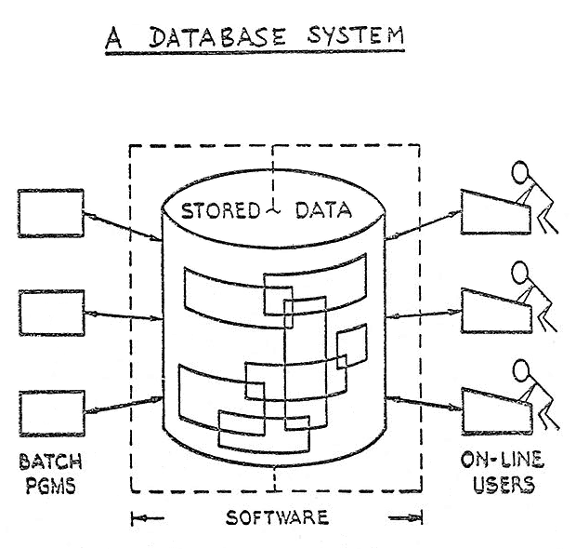
Database is abstract concept. So what implements database??
It’s Database Management Systems (DBMS)
A database management system (DBMS) is a computer software application that interacts with the user, other applications, and the database itself to capture and analyze data.

Slide 19
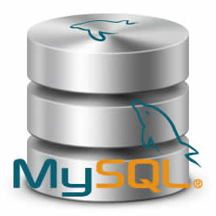
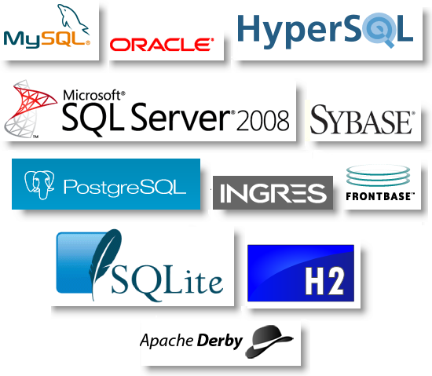


What are the popular DBMS available till now??
DB2
MySQL
Oracle
PostgreSQL
SQLite
SQL Server
Sybase

Slide 20
Data Manipulation Language (DML)
Language for accessing and manipulating the data organized by the appropriate data model
DML also known as query language
Two classes of languages
Procedural – user specifies what data is required and how to get those data
Declarative (nonprocedural) – user specifies what data is required without specifying how to get those data
SQL is the most widely used query language

Slide 21

So which one is our choice??
It is none other than the one and only Mr.Oracle
Oracle is someone legendary who foresee the future.

Slide 22
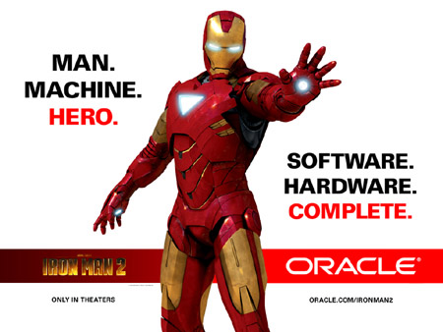
So why Oracle???
World’s top 10 banks run Oracle applications
Efficient recovery from human errors .
Faster database recovery
Atomicity
Consistency
Isolation
Durability

Slide 23
Some Terminologies
User
Schema
DBA
Table
Row
Column
Field
Record
SQL
Query
etc

Slide 24
Let us Start with the Oracle
User Creation
Granting privileges
Creating table
Inserting data into table
View Table descriptions
View table data
Etc.

Slide 25
Thank You

